Slide 1


Design & Develop Front End Community Portal
Module Project
Module: NICF-UI Frameworks
Course: NICF-Advanced Certificate in Web Development
Start Date : 21 June 2022
End Date : Submission Date :
Learner Name Enrollment ID
:
:
Wildan Luqmanul Hakim
19 July 2022
BDSE04-0322
16 July 2022
Presentation Date :

Slide 2
Document History
Version Number | Effective Date of release | Summary of Included Changes | Author
1 | 4th March 2016 | First Edition | Satya CVS
2 | 7th April 2017 | Changed for Module 2 | Shrinivas K R
3 | 14th May 2017 | Changed for Module 3 | Shrinivas K R
4 | 03rd May 2018 | Changed for RQF | Shrinivas K R
5 | 16th Sep 2018 | Change for Java Track | Shrinivas K R

Slide 3
Contents
S. No. | Description
01 | Development Tools
02 | Feedback Techniques
03 | Pages Inventory
04 | Forms & Pages Design
05 | Forms & Pages Feedback
06 | HTML Pages
07 | Usability Metrics
08 | User Interaction Steps
09 | User Interaction Flowchart
10 | Current & Desired Usability
11 | Prototype Screen
12 | Prototype Feedback
13 | Usability Test
14 | Project Milestones & Tasks
15 | Milestone Feedback & Action taken
16 | Project Results
17 | Proposed Improvements

Slide 4


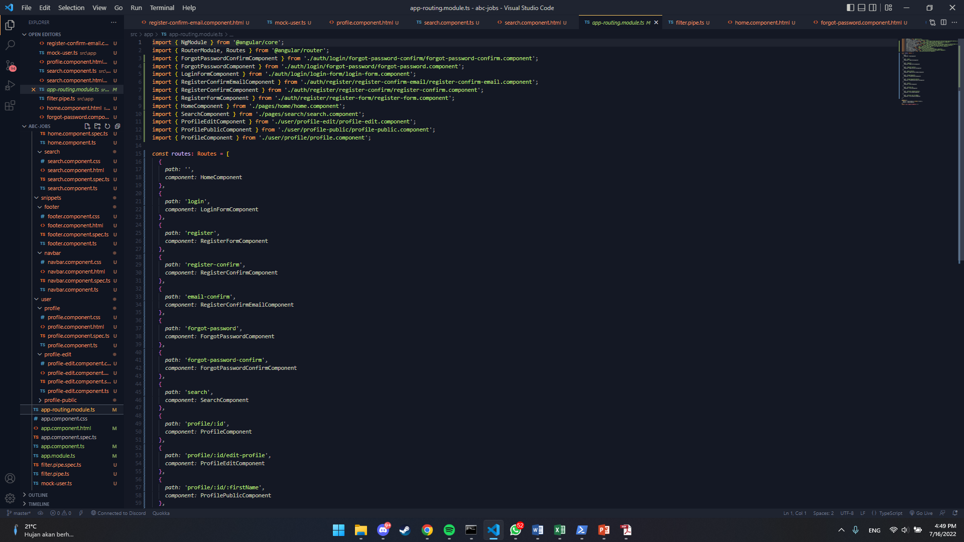
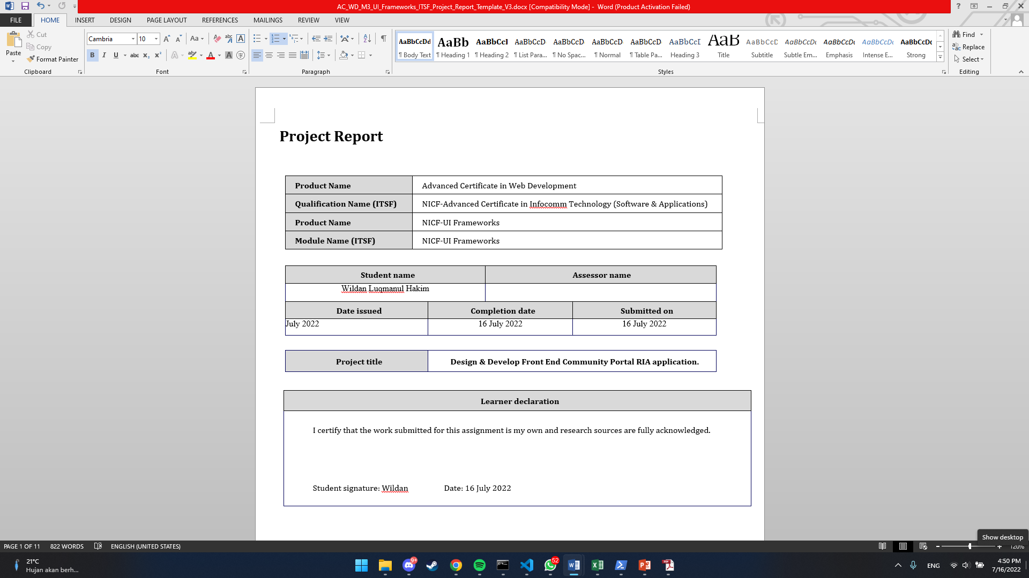
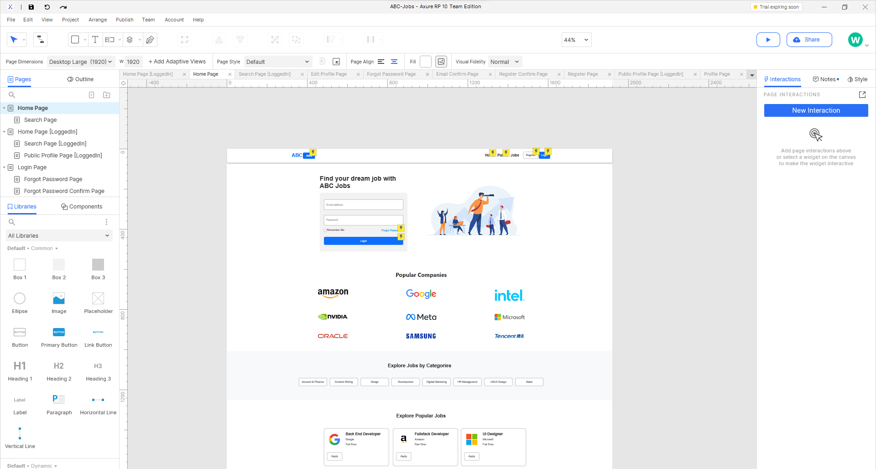
1. Development Tools
Development Tools Screen captures
Visual Studio Code
Microsoft Word
Axure RP 10

Slide 5

2. Feedback Techniques
Feedback gathering techniques
Qualitative
Explore
Go Deep
Seek to Understand
Quantitative
Quantify
Validate
Make Decisions

Slide 6
3. Pages Inventory
List of Pages for which UI need to be developed
S. No. | Page Name
1 | Community Portal Home Page
2 | Registration Page
3 | Registration Confirmation Page
4 | Update Profile Page
5 | Search Users Page
6 | List Search Results
7 | Public Profile Page
8 | Registration Confirmation Email
9 | Login Page
10 | Forget Password Page
11 | Design the Forget Password Confirmation Page

Slide 7
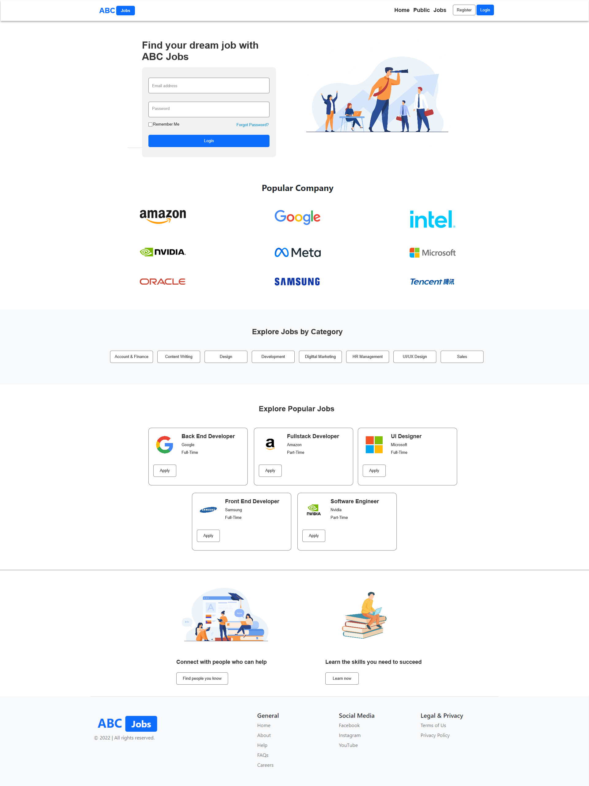
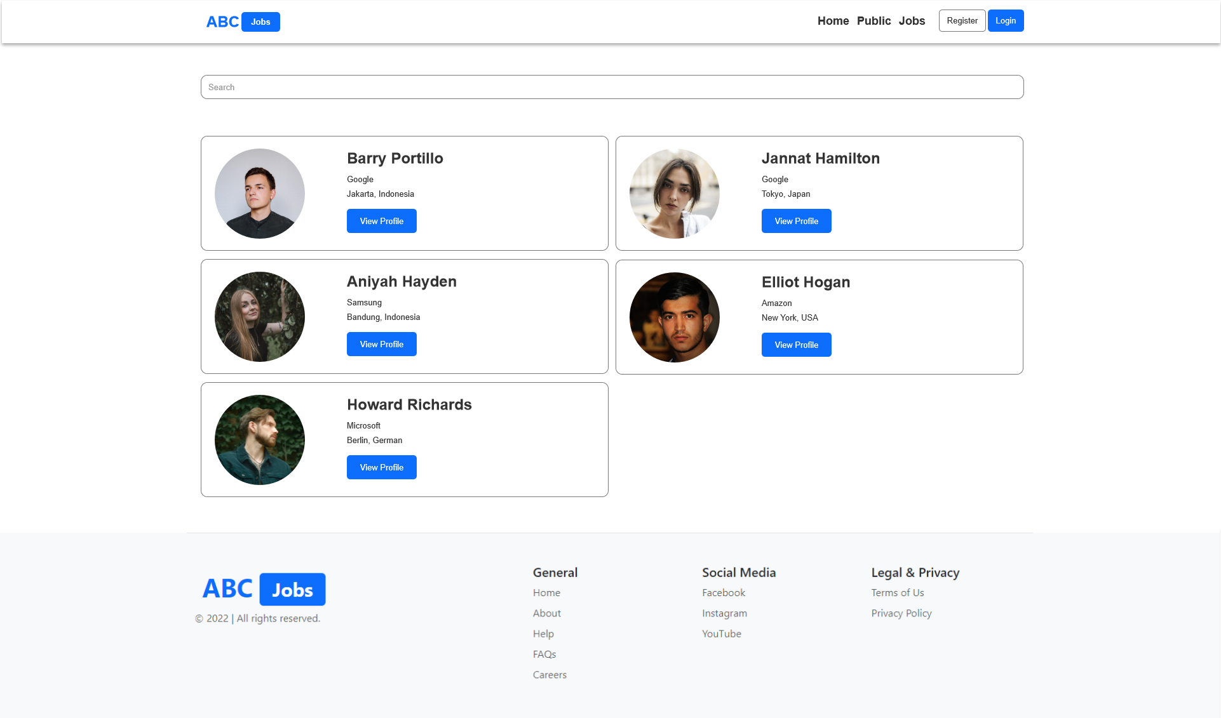
4. Forms & Pages Design
Home Page
Search Users Page

Slide 8
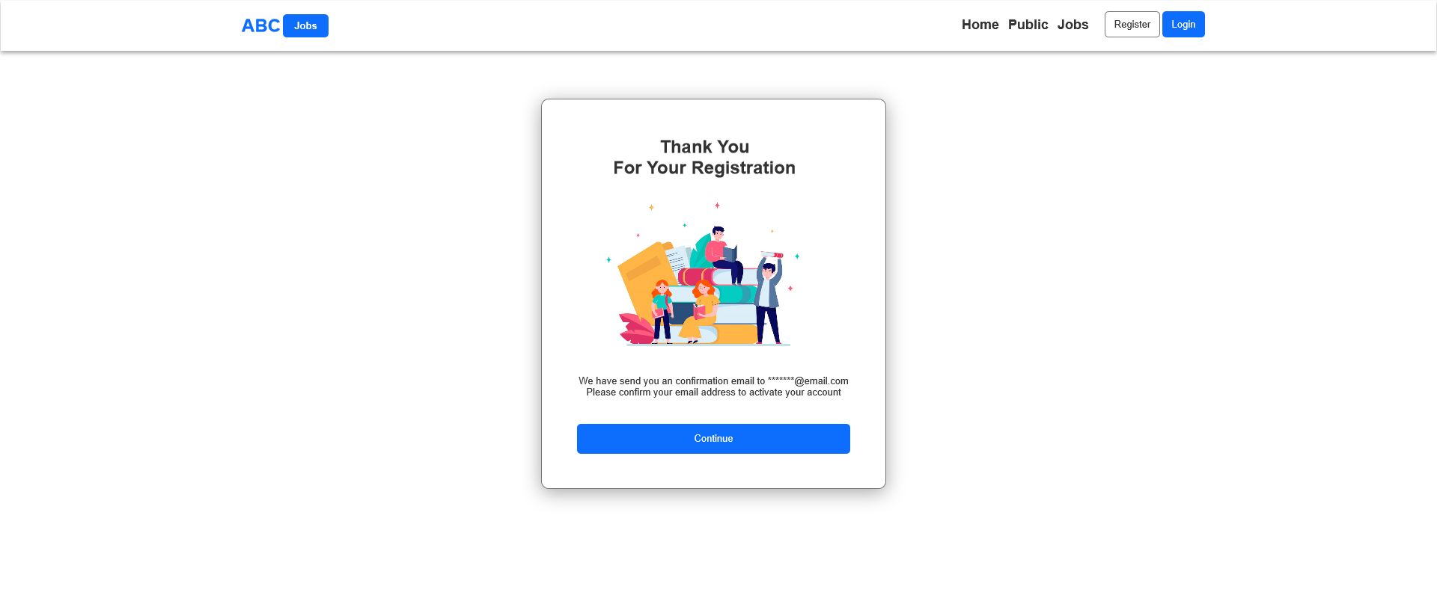
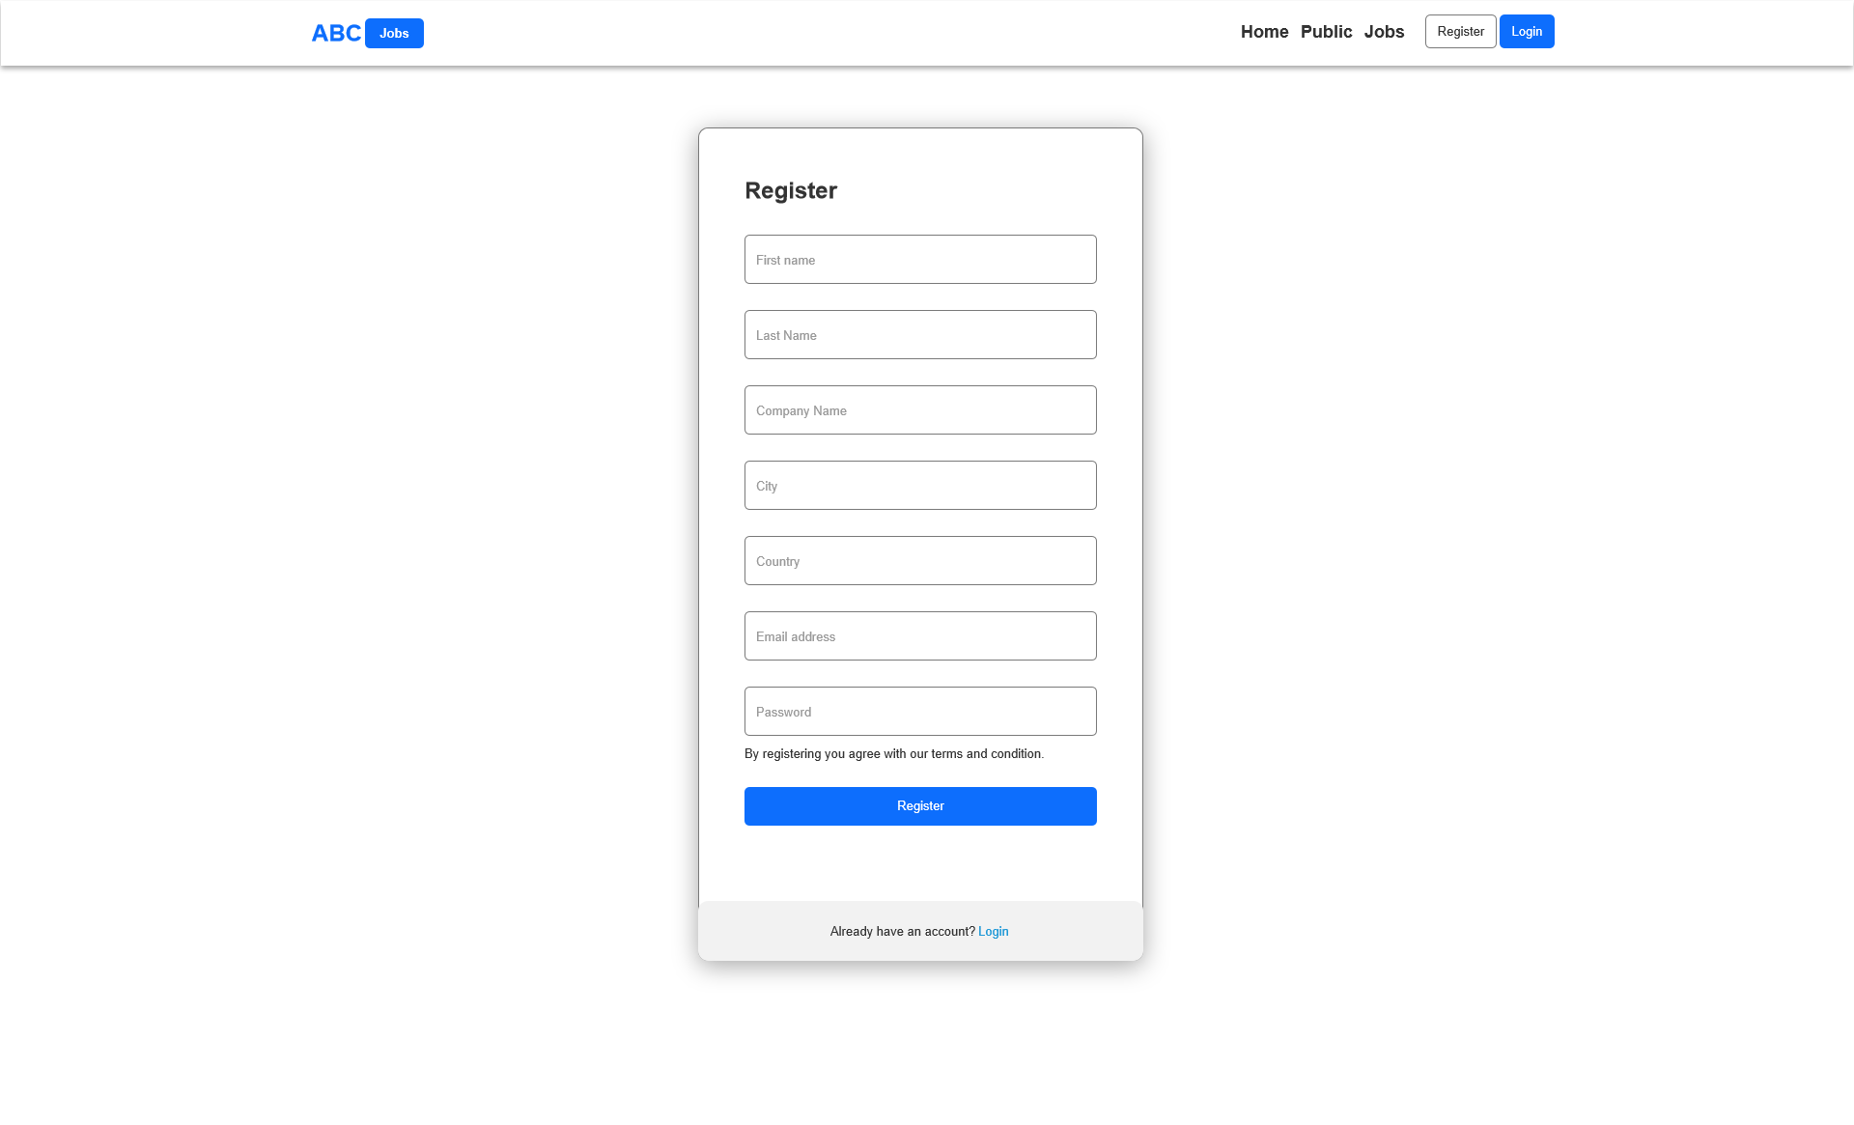
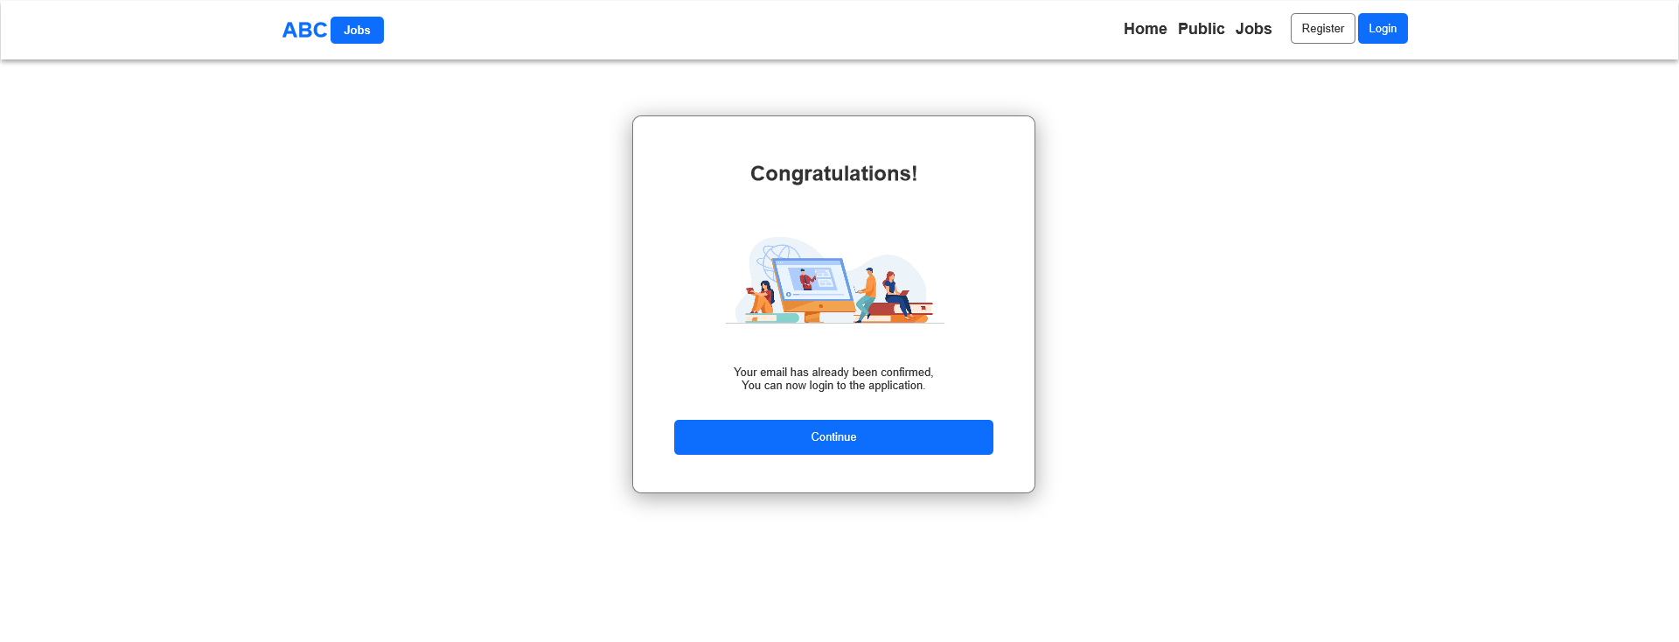
4. Forms & Pages Design
Register Confirm Page
Register Page
Register Confirm Email Page

Slide 9
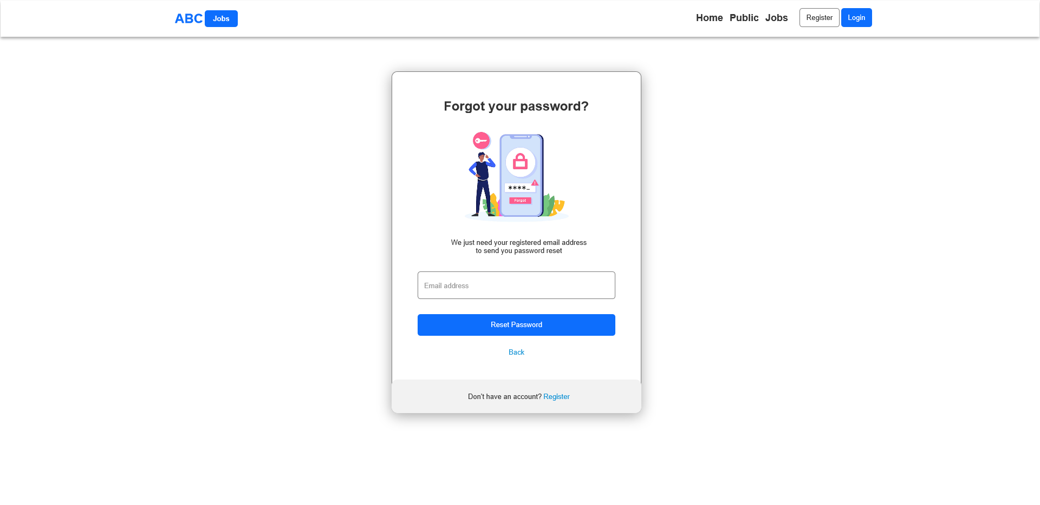
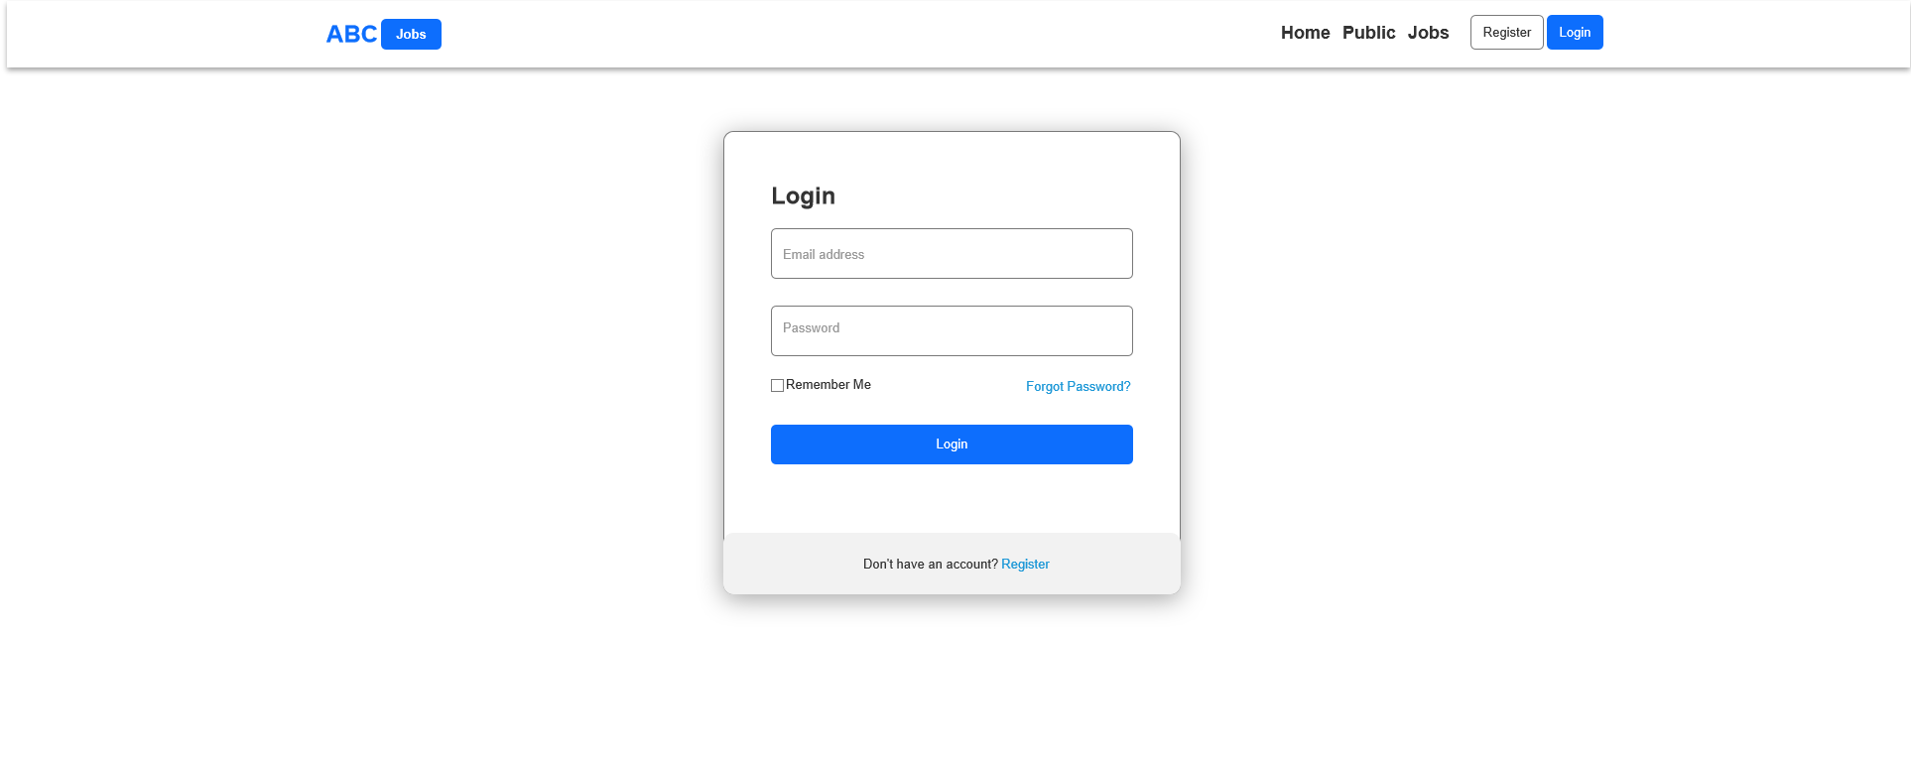
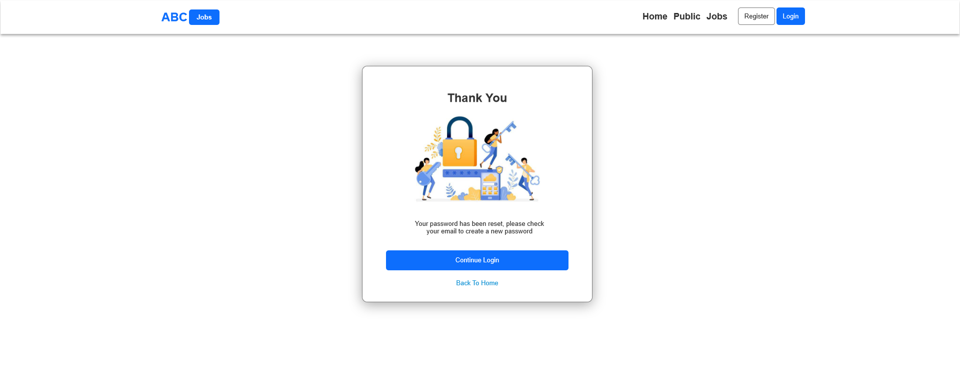
4. Forms & Pages Design
Forgot Password Page
Login Page
Forgot Password Confirm Page

Slide 10
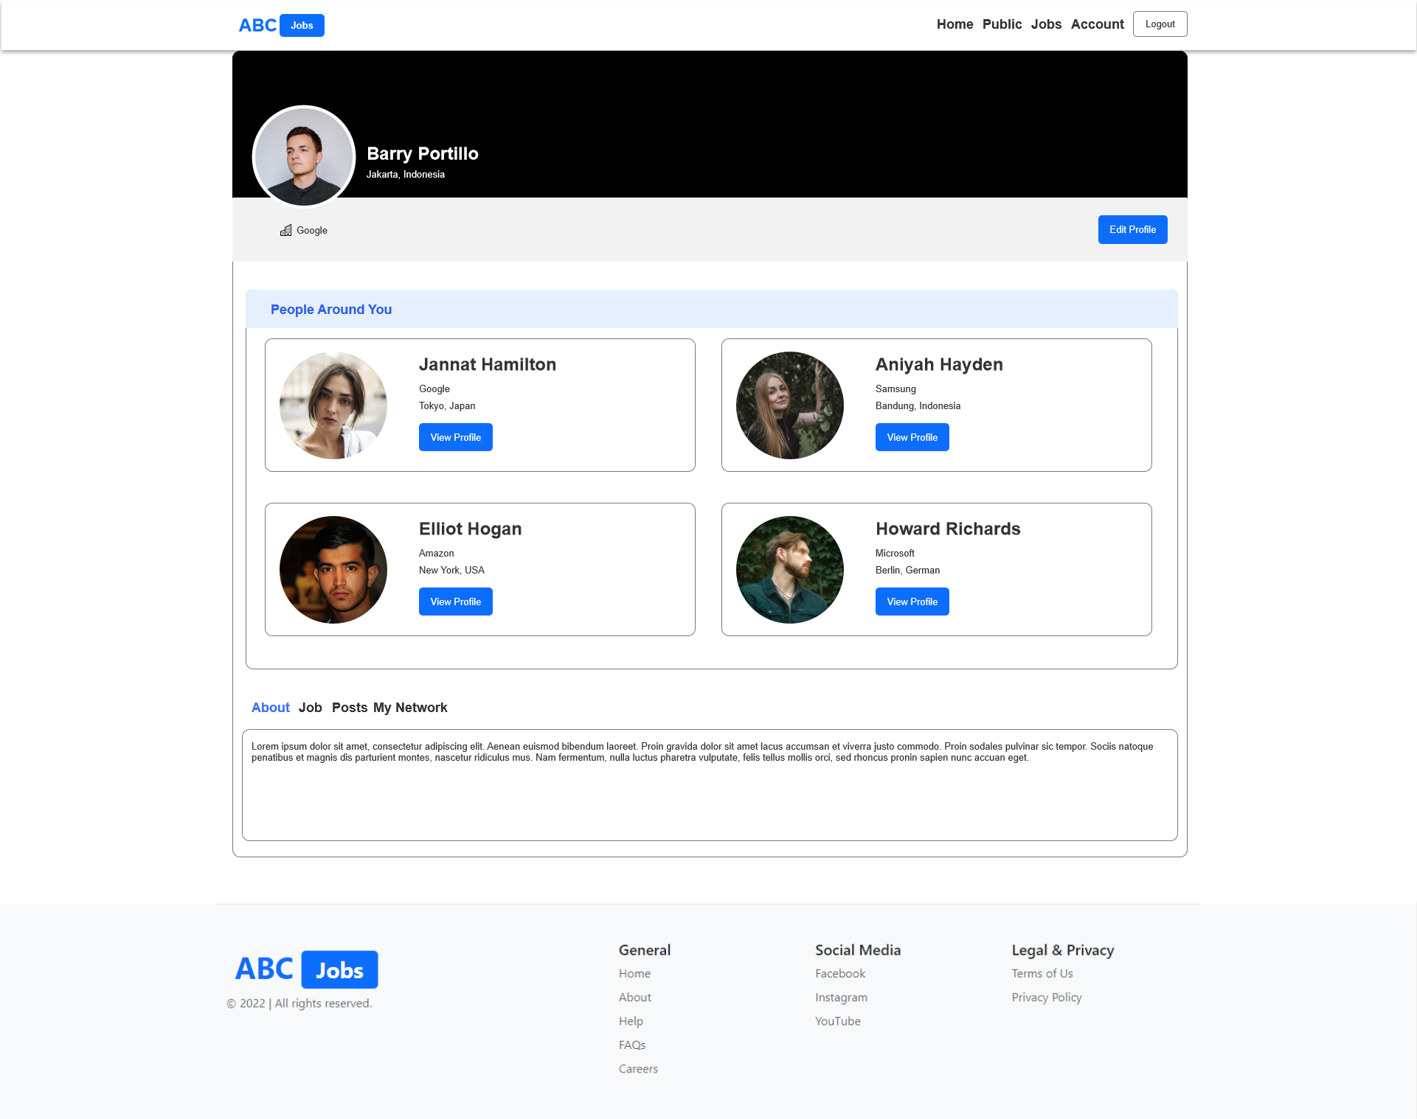
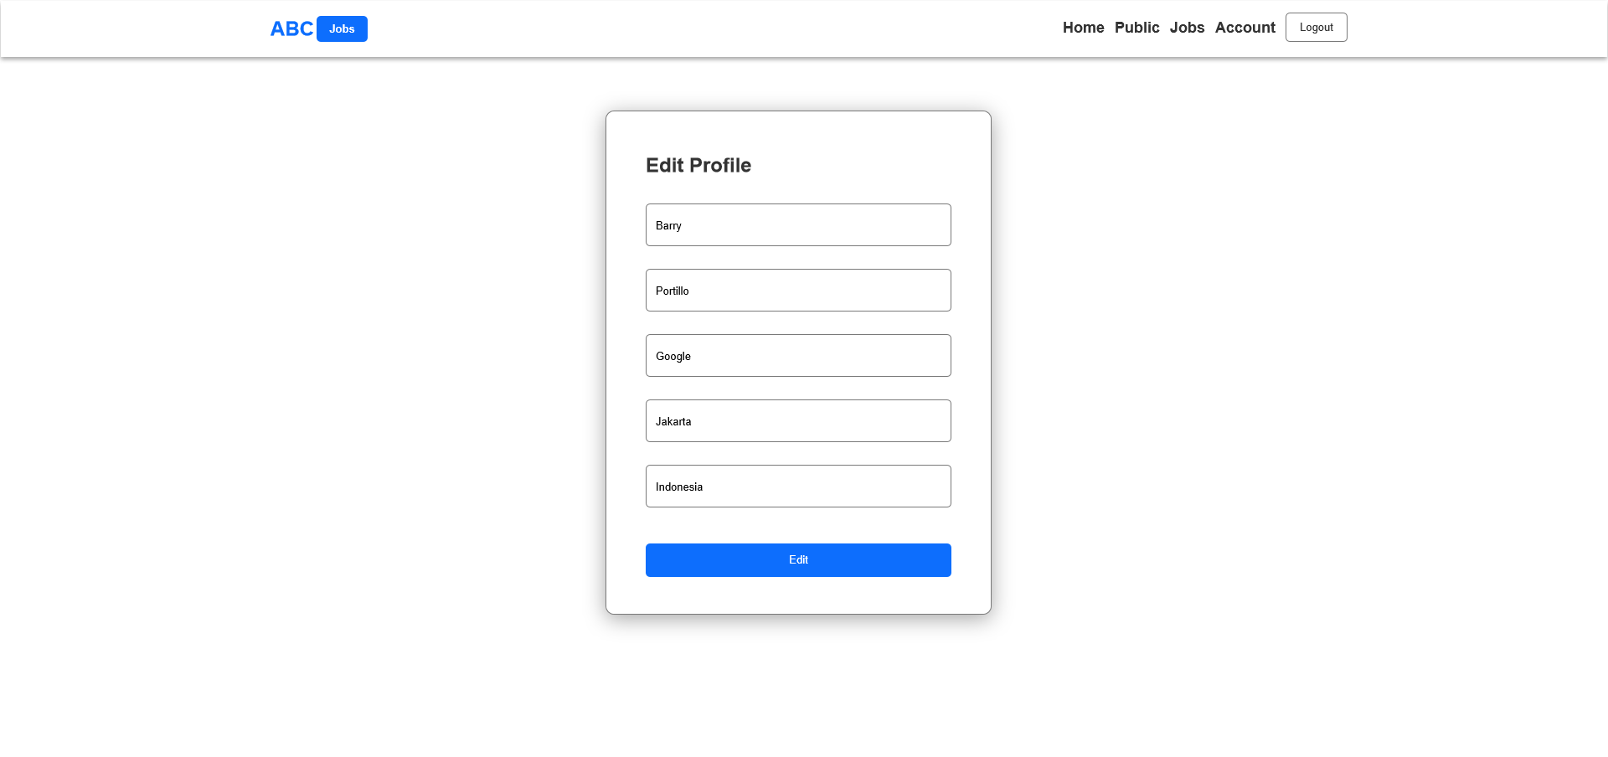
4. Forms & Pages Design
Profile Page
Edit Profile Page

Slide 11
5. Forms & Pages Feedback
S. No. | Forms / Pages | Feedback Received | Modifications Implemented
1 | Profile Page | Change the Profile page to Public profile page without edit button | Yes

Slide 12

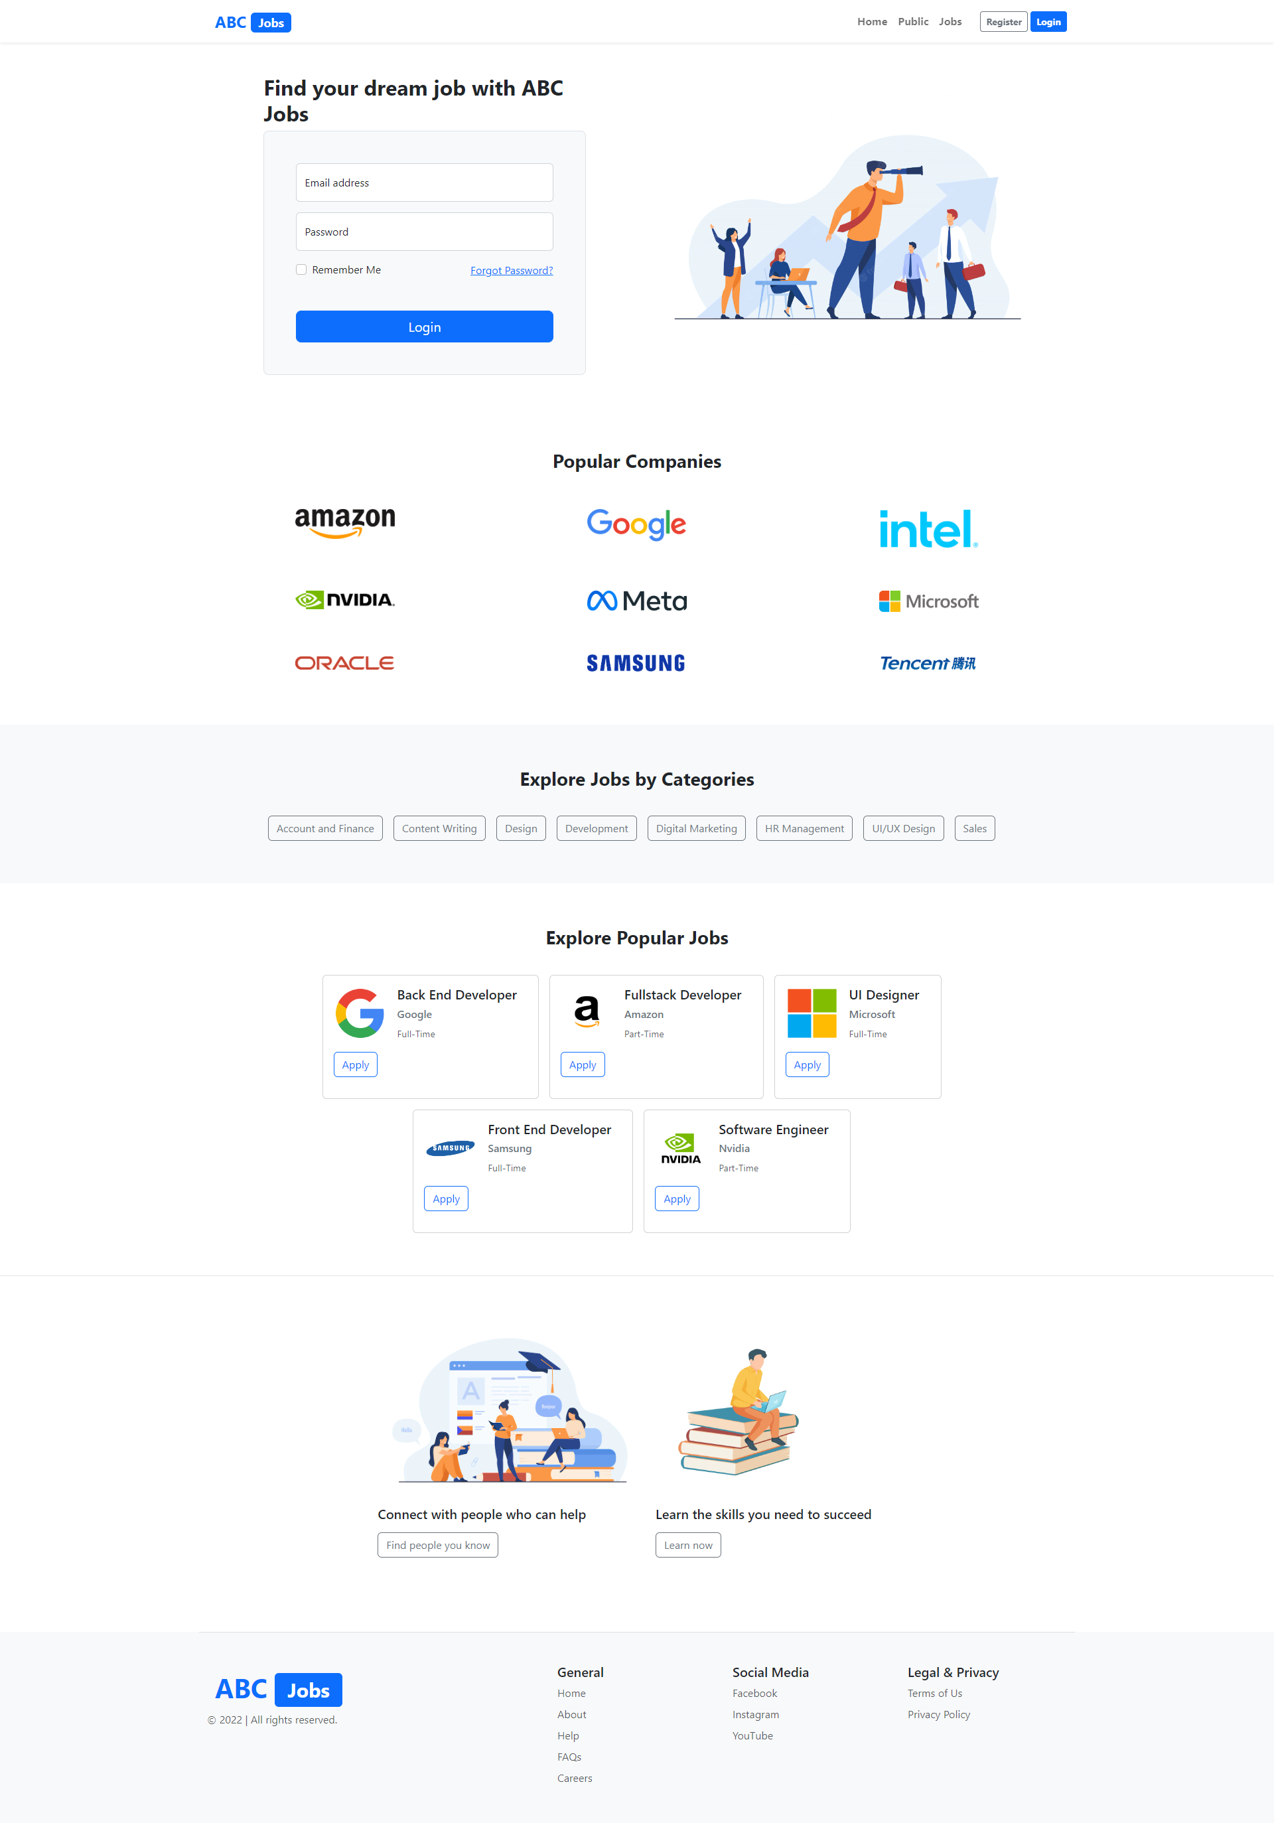
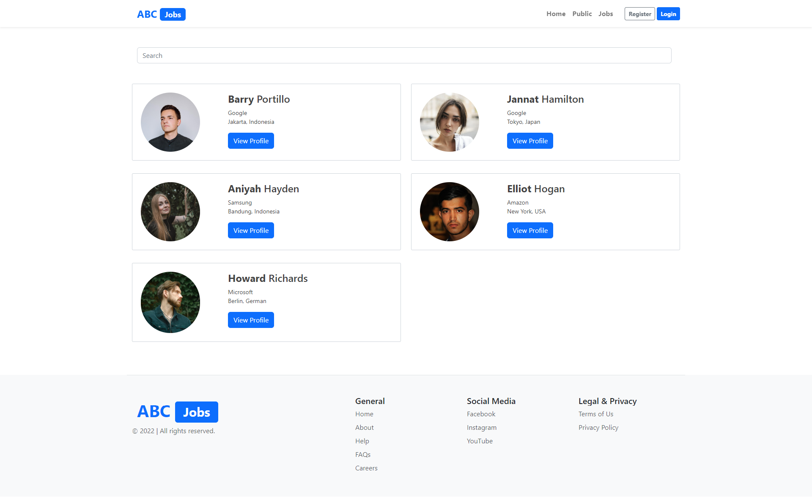
6. HTML Pages
Screen capture of Pages
Search Users Page
Home Page

Slide 13
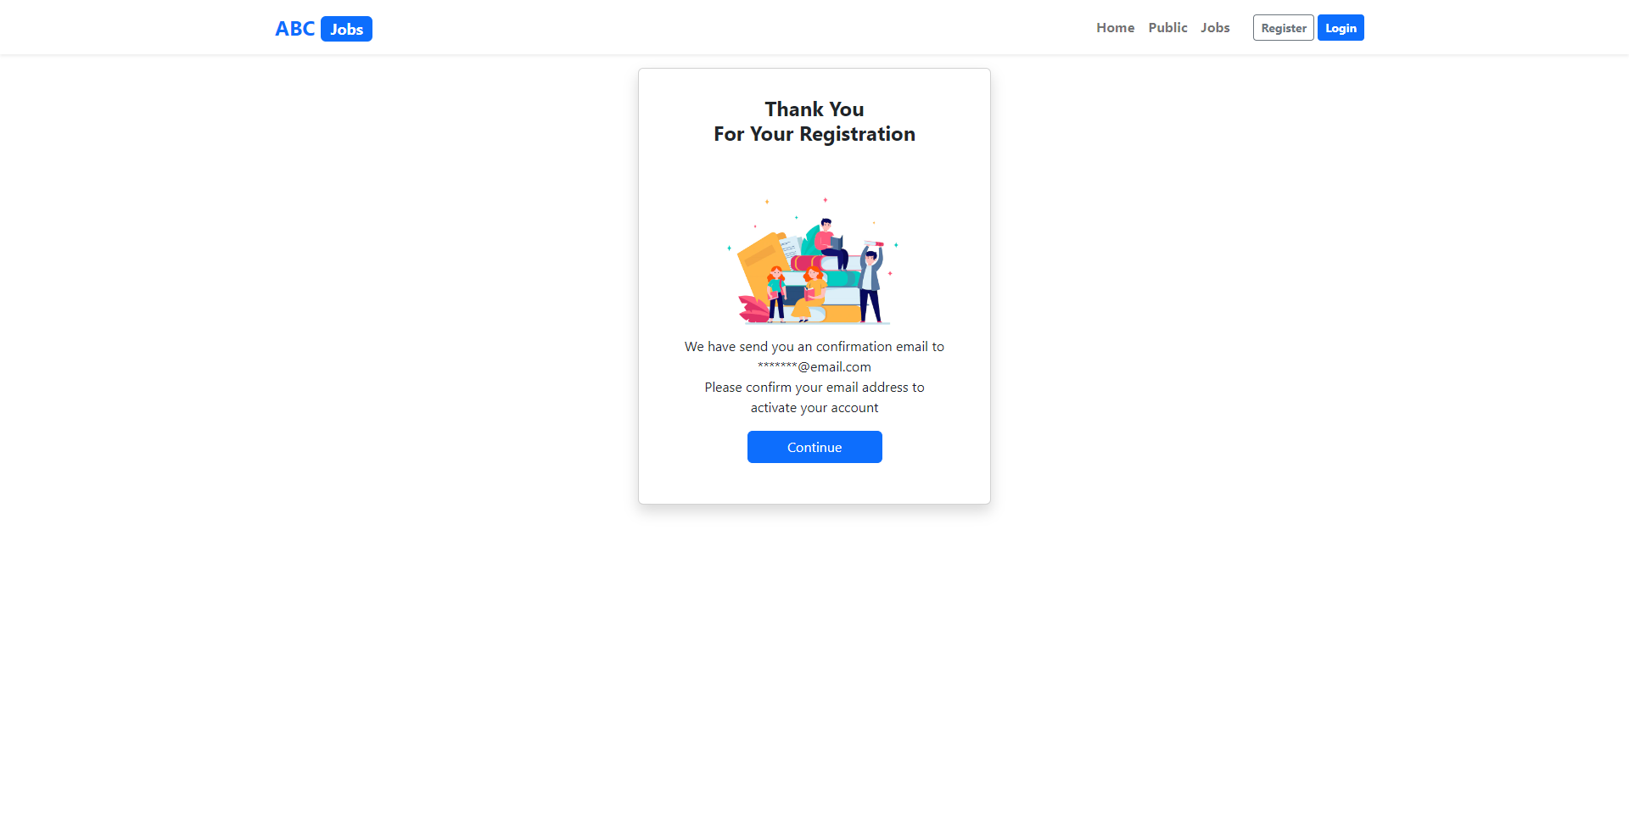
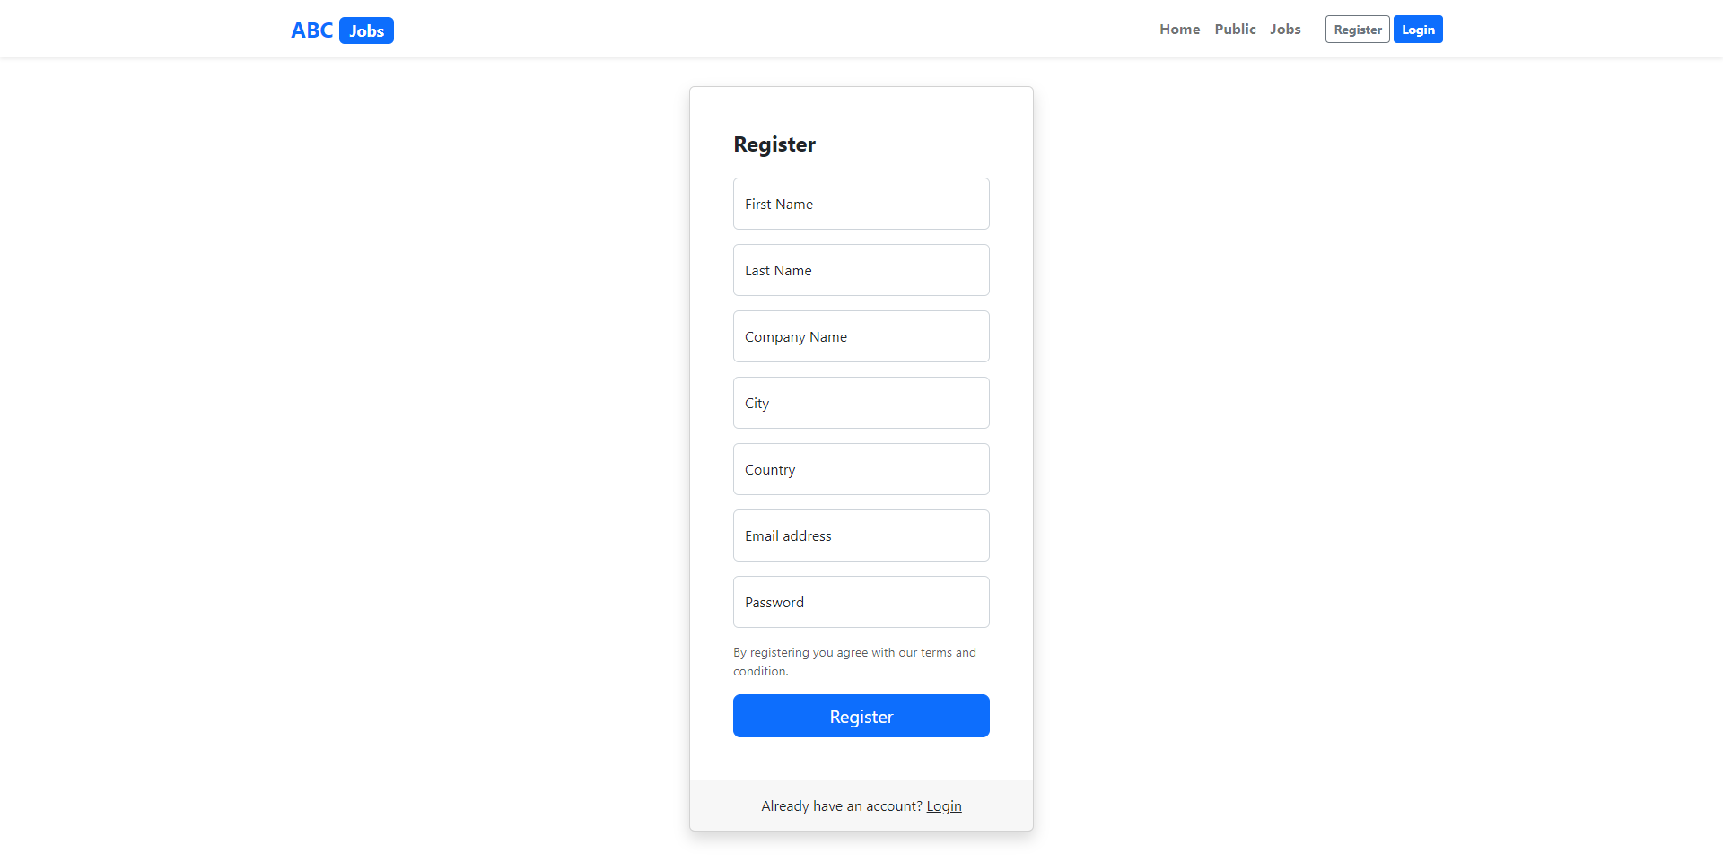
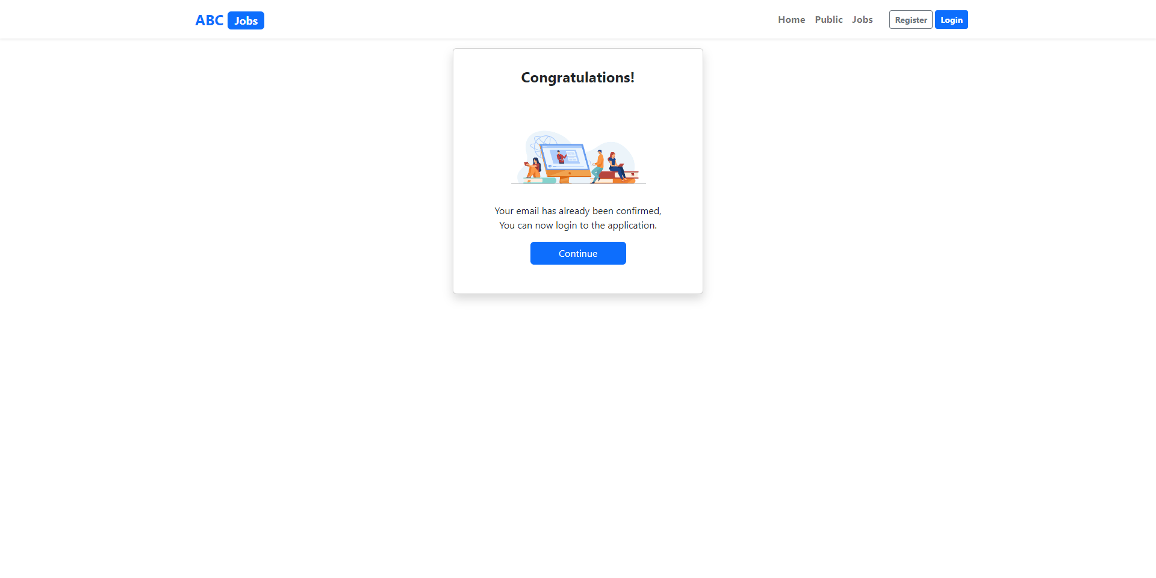
6. HTML Pages
Screen capture of Pages
Register Confirm Page
Register Page
Register Confirm Email Page

Slide 14
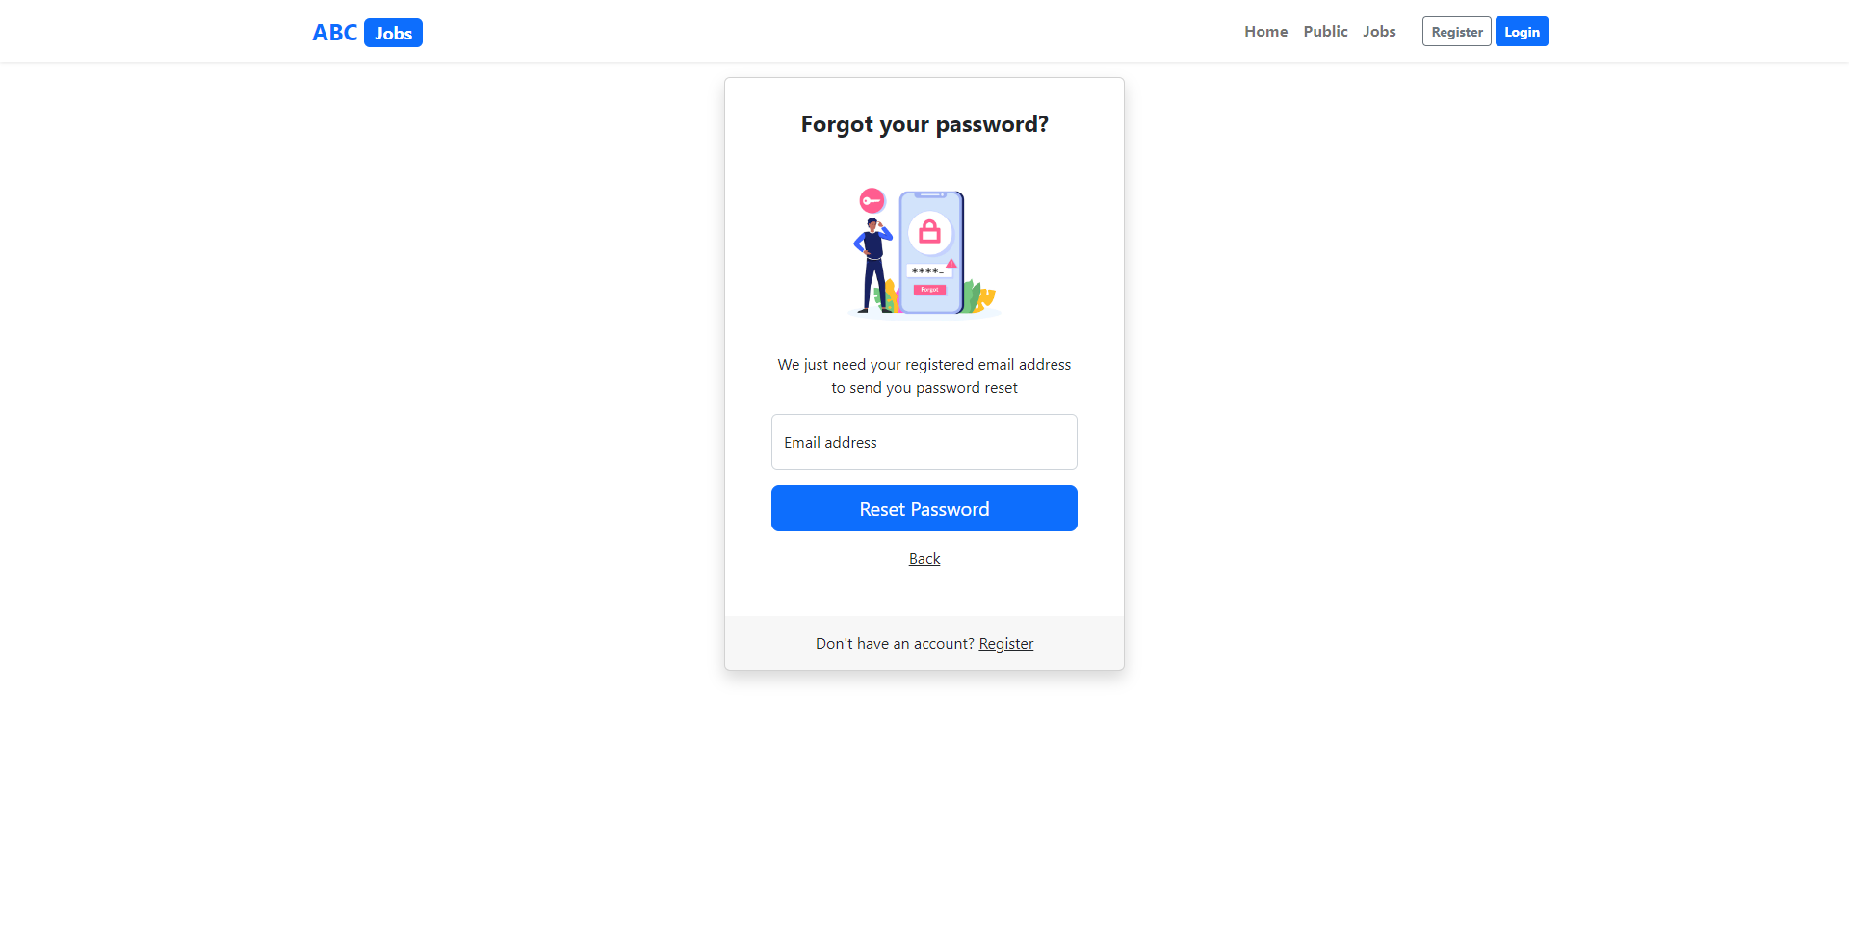
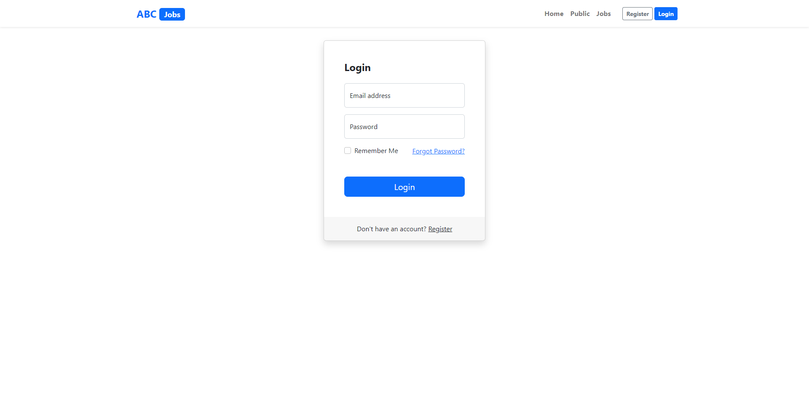
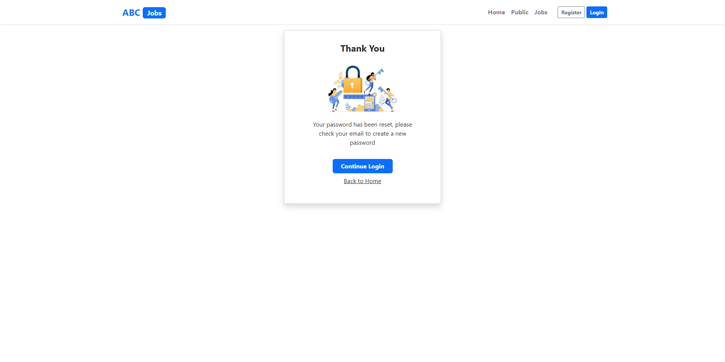
6. HTML Pages
Screen capture of Pages
Forgot Password Page
Login Page
Forgot Password Confirm Page

Slide 15
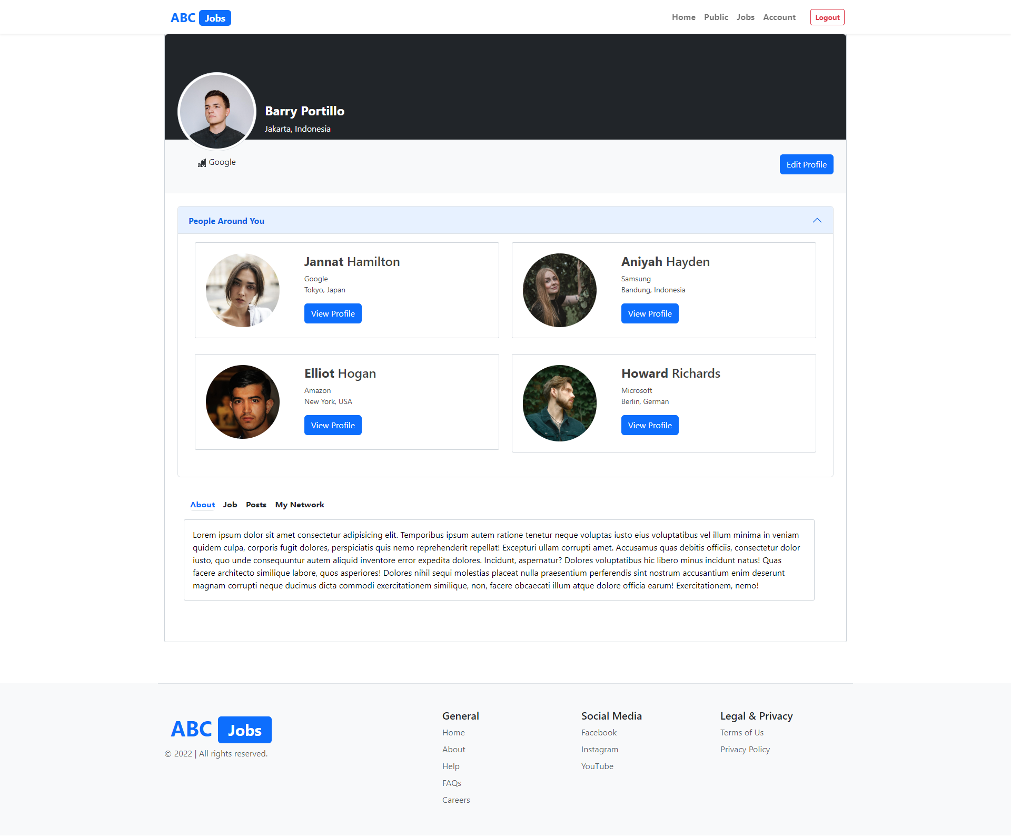
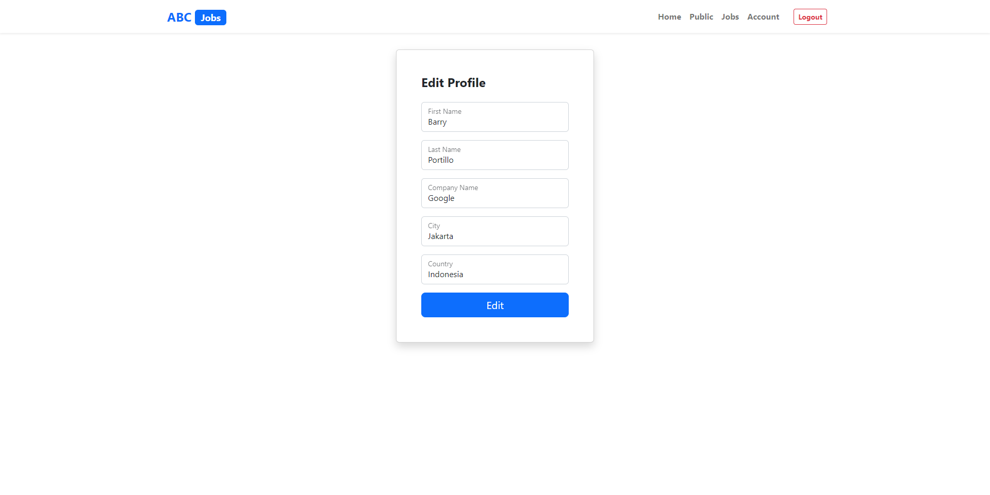
6. HTML Pages
Screen capture of Pages
Profile Page
Edit Profile Page

Slide 16
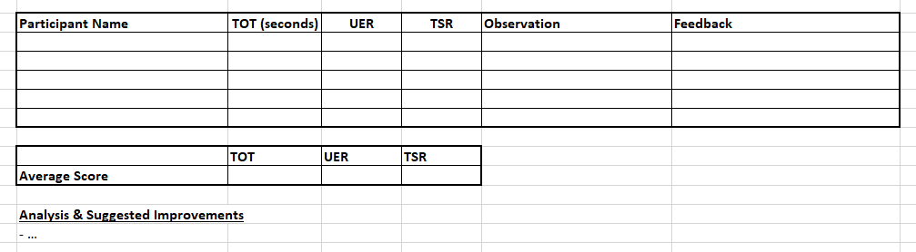
7. Usability Metrics
TOT (Time On Task)
UER (User Error Rate)
TSR (Task Success Rate)

Slide 17
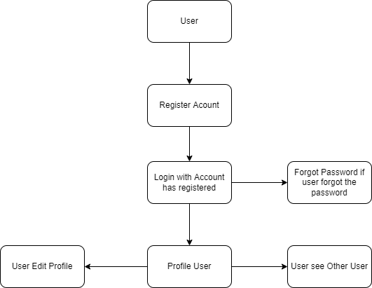
8. User Interaction Steps

Slide 18
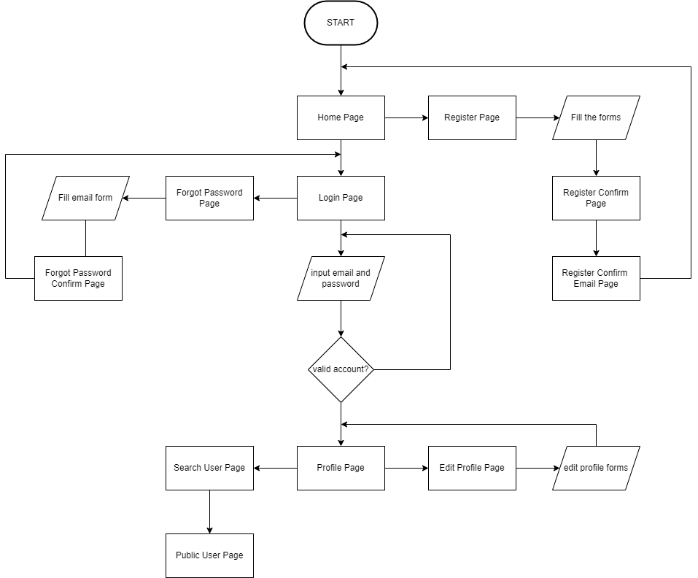
9. User Interaction Flowchart

Slide 19
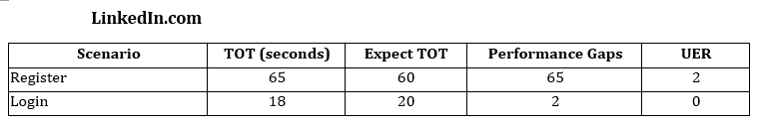
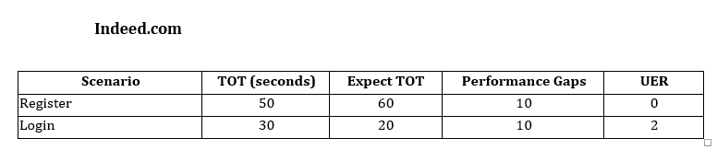
10. Current & Desired Usability

Slide 20
11. Prototype Screen
Register Scenario
Register Confirm Page
Register Page
Register Confirm Email Page

Slide 21
11. Prototype Screen
Login Scenario
Login Page
Profile Page

Slide 22
11. Prototype Screen
Forgot Password Scenario
Forgot Password Page
Login Page
Forgot Password Confirm Page

Slide 23
11. Prototype Screen
Edit Profile Scenario
Profile Page
Profile Page

Slide 24
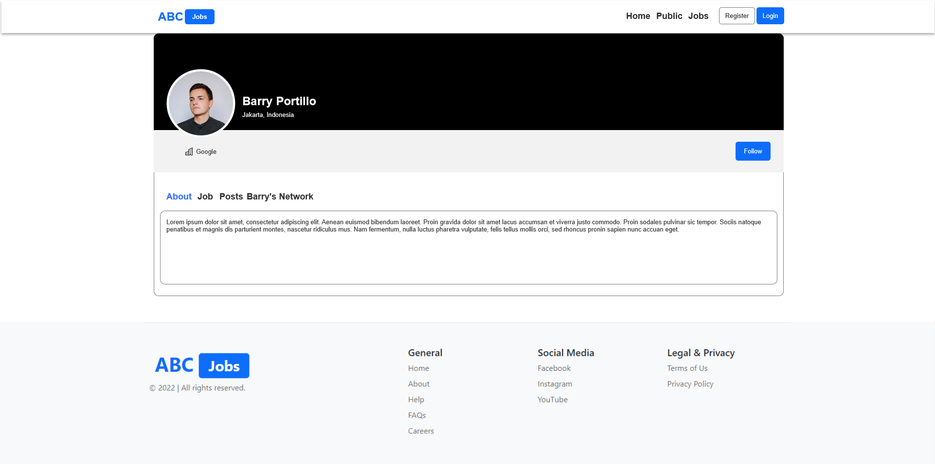
11. Prototype Screen
Search User Scenario
Search User Page
Profile Public Page

Slide 25
12. Prototype Feedback
Register Page
User can’t see the password has been typed, will make show password button
User need to check for Terms of Service
Login Page
Make show password button
Add warning for email and password form
Edit Profile
Add Edit Picture
Add Cover Picture Profile

Slide 26
13. Usability Test
Register an Account
Participant Name | TOT (seconds) | UER | TSR | Observation | Feeback
Dimas | 30 | 0 | Success | No Issue | Excellent
Achmad | 50 | 1 | Success | Can’t see password | Add show password
Rivan | 20 | 0 | Success | All Good | Great
Sabar | 55 | 2 | Success | Good | Add check button for Terms of Service
Dandy | 20 | 0 | Success | Easy to Fill | -
 | TOT | UER | TSR
Average Score | 35 | 12% | 100%
Login with account has been registered
Participant Name | TOT (seconds) | UER | TSR | Observation | Feeback
Dimas | 19 | 0 | Success | Invalid Email | Add warning form
Achmad | 15 | 1 | Success | Can’t see password | Add show password
Rivan | 14 | 0 | Success | All Good | Great
Sabar | 12 | 0 | Success | No Issue | Nice
Dandy | 20 | 1 | Success | Wrong Password | Add show password
 | TOT | UER | TSR
Average Score | 16 | 8% | 100%

Slide 27
13. Usability Test
Edit Profile
Participant Name | TOT (seconds) | UER | TSR | Observation | Feeback
Dimas | 40 | 3 | Success | Great | Add the edit picture
Achmad | 50 | 0 | Success | Nice | -
Rivan | 33 | 1 | Success | No Cover Picture Profile | Add Cover Picture Profile
Sabar | 25 | 0 | Success | No Issue | Nice
Dandy | 44 | 0 | Success | No Issue | Good
 | TOT | UER | TSR
Average Score | 37.4 | 8% | 100%

Slide 28
14. Project Milestones & Tasks
Project Task ID | Project Task Description | Project Milestone ID
1 | Create requirement specification | 1
2 | Develop wireframe/prototype for the website | 1
3 | Develop user interaction steps and flowchart | 1
4 | Develop HTML Pages with Bootstrap and Angular | 2
5 | Analysis user experience | 2
6 | Test the application | 2

Slide 29
15. Milestone Feedback & Action taken
Project Milestone ID | Milestone Feedback received from Tutor / Learning Facilitator | Action Taken (Yes / No)
1 | Add warning for email and password form | Yes
2 | Add images to the profile page | Yes

Slide 30

16. Project Results (1/2)
List of HTML Pages being Produced
Home Page
Search User Page
Register Page
Register Confirm Page
Register Confirm Email Page
Login Page
Forgot Password Page
Forgot Password Confirm Page
Profile Page
Profile Public Page
Profile Edit Page
Links of the Pages
Localhost:4200
Localhost:4200/search
Localhost:4200/register
Localhost:4200/register-confirm
Localhost:4200/email-confirm
Localhost:4200/login
Localhost:4200/forgot-password
Localhost:4200/forgot-password-confirm
Localhost:4200/profile/:id
Localhost:4200/profile/:id/:firstName
Localhost:4200/profile/:id/edit-profile

Slide 31

16. Project Results (2/2)
Screen Capture of Pages Using Bootstrap & Angular
Search Users Page
Profile Page
Home Page
Register Page
Login Page

Slide 32

17. Proposed Improvements
List of Improvements
Make it easy for users to register an account
Minimize errors when interacting with users

